Slide 1


Quantitative Evaluation of LoRa for DoD Applications
MAS CAPSTONE Project
Bryce Rooney
University of California, San Diego (UCSD)
Master’s of Advance Study (MAS) - Wireless Embedded Systems

Slide 2
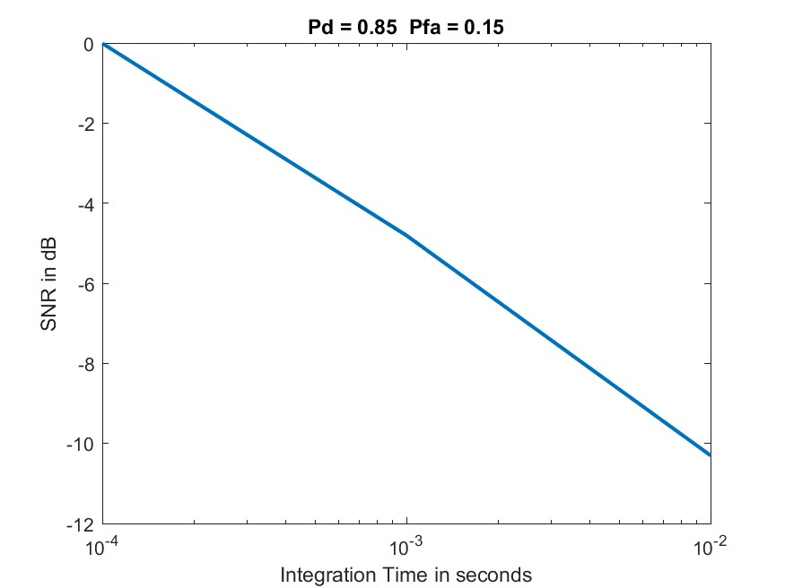
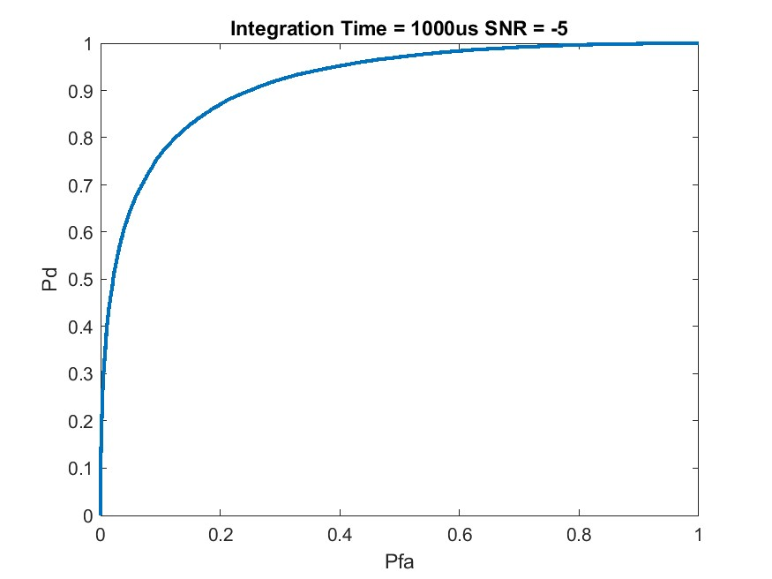
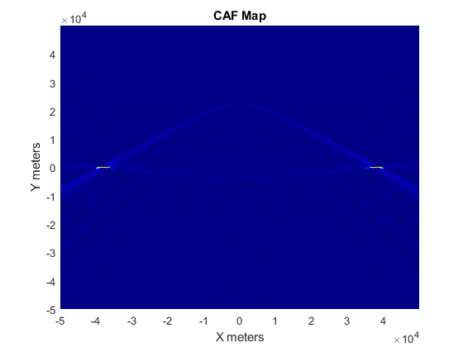
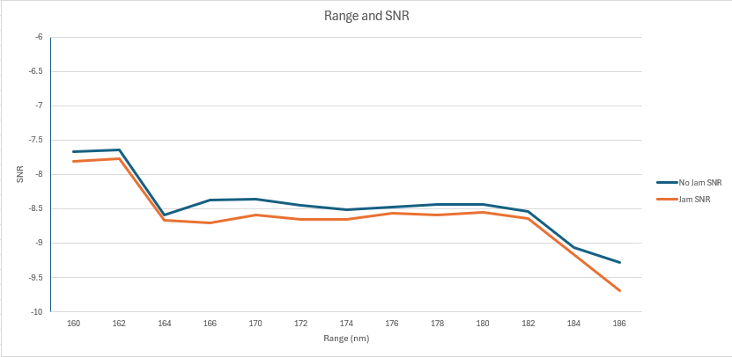
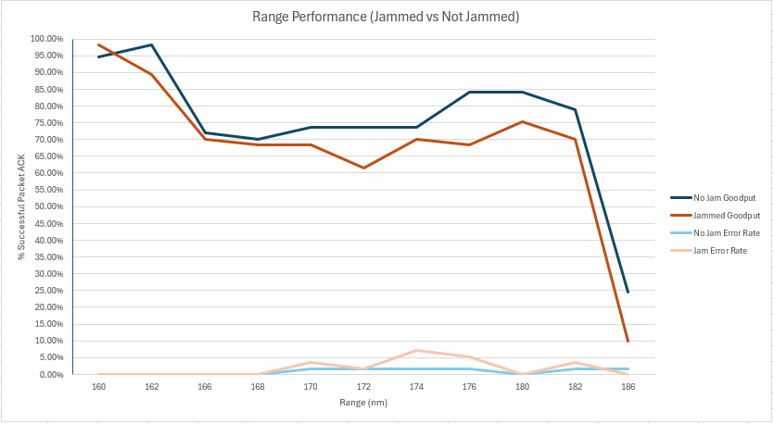
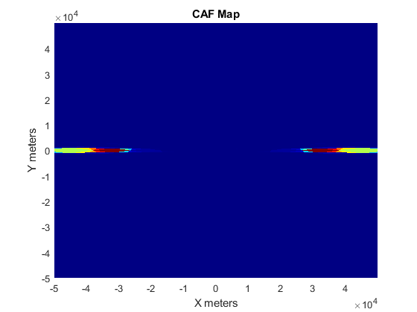
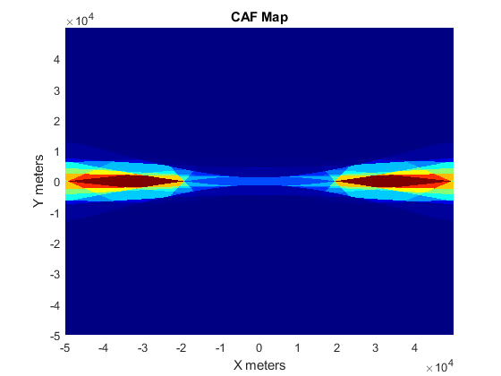
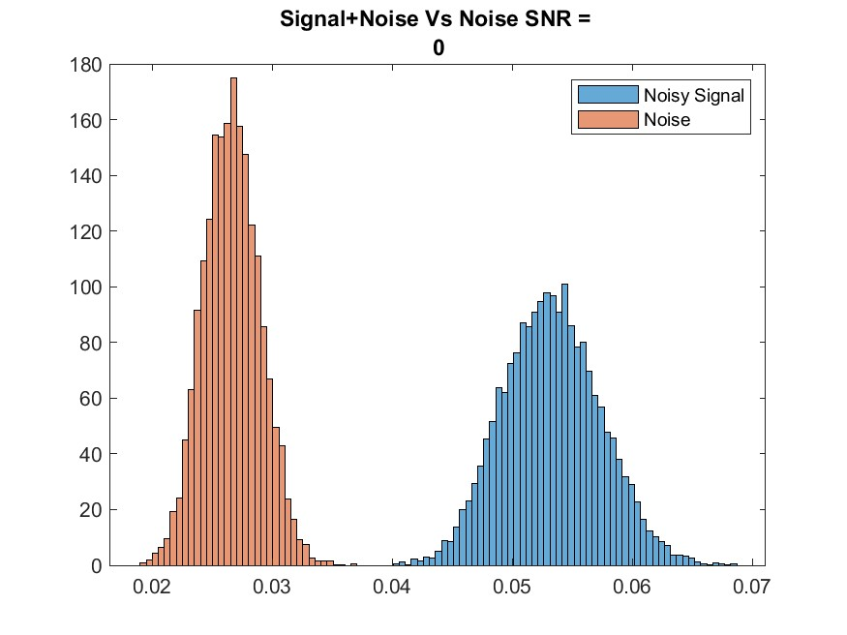
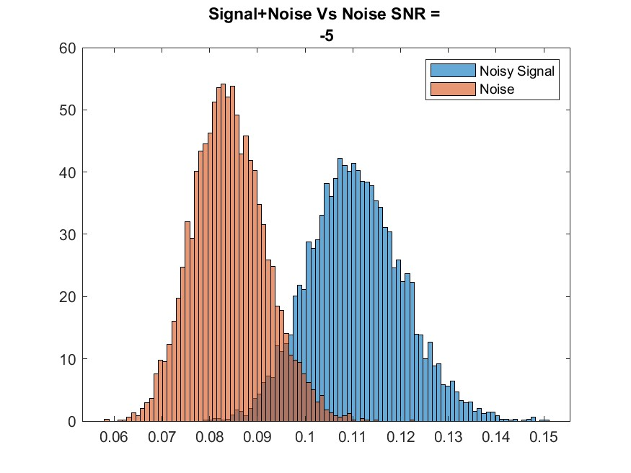
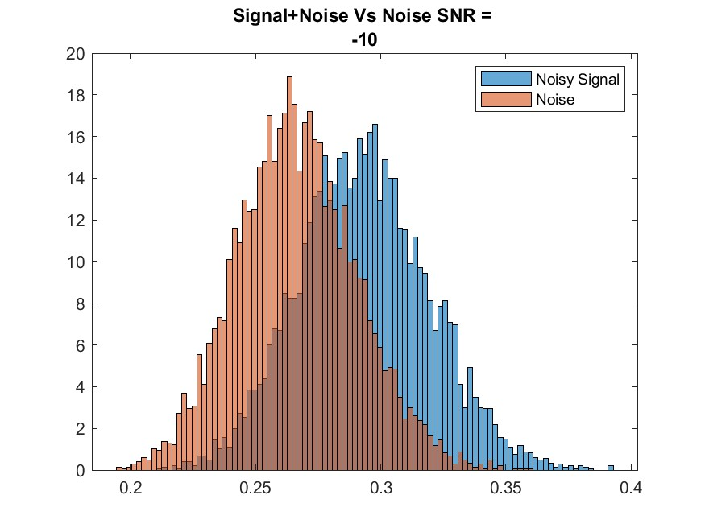
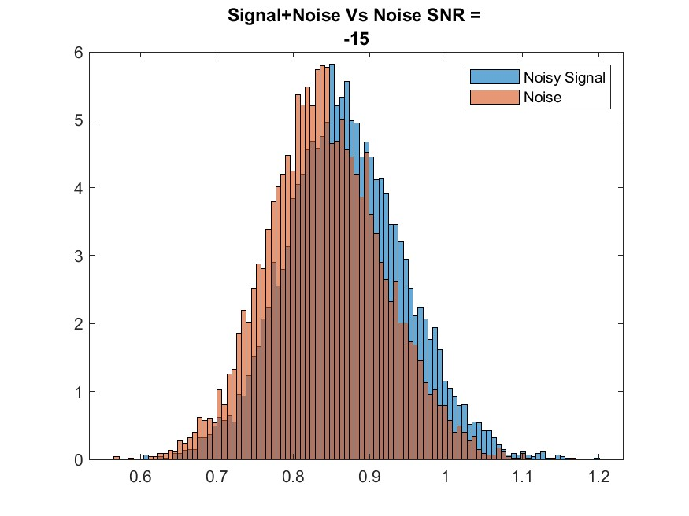
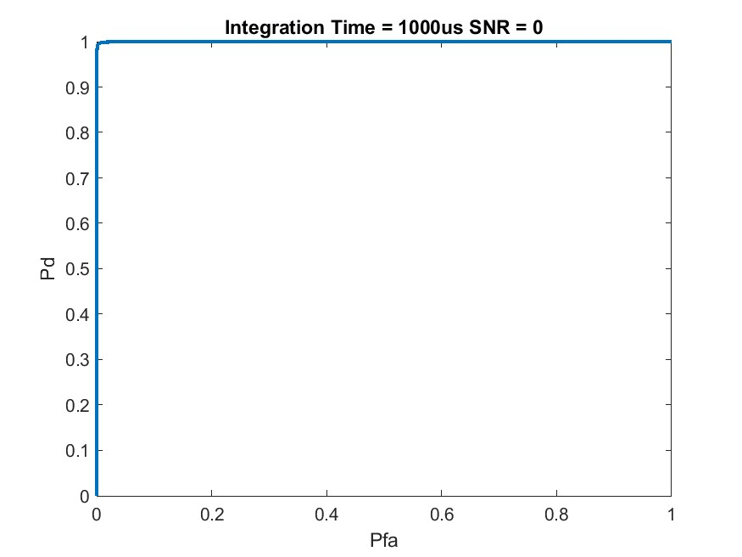
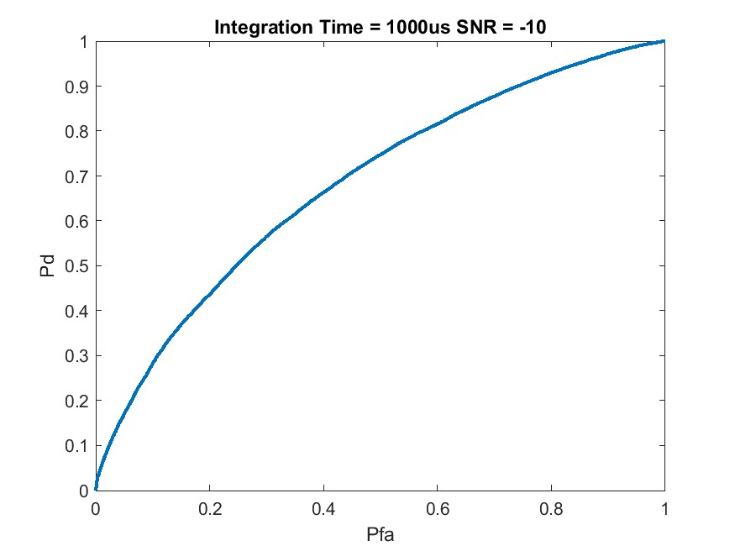
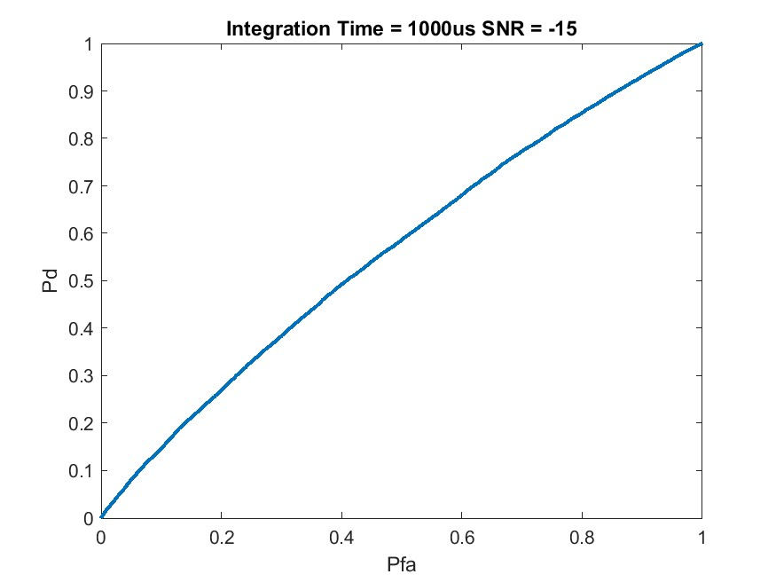
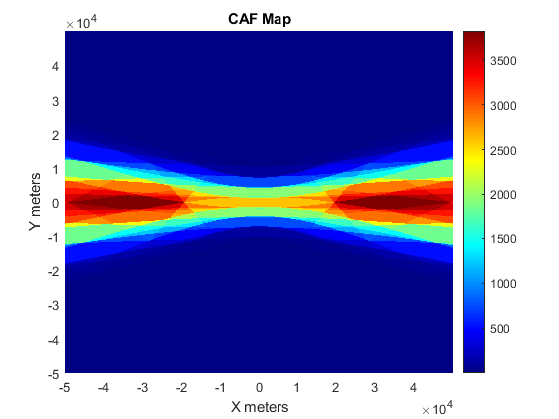
Lots of Data, Results, and Interpretation….

Slide 3

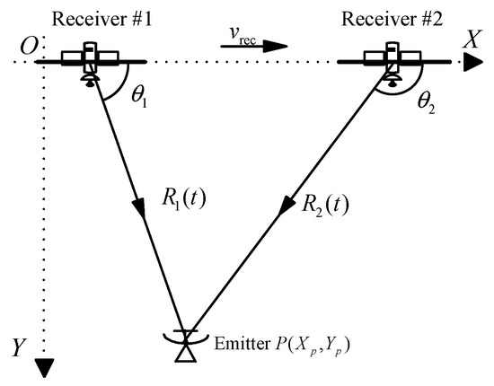
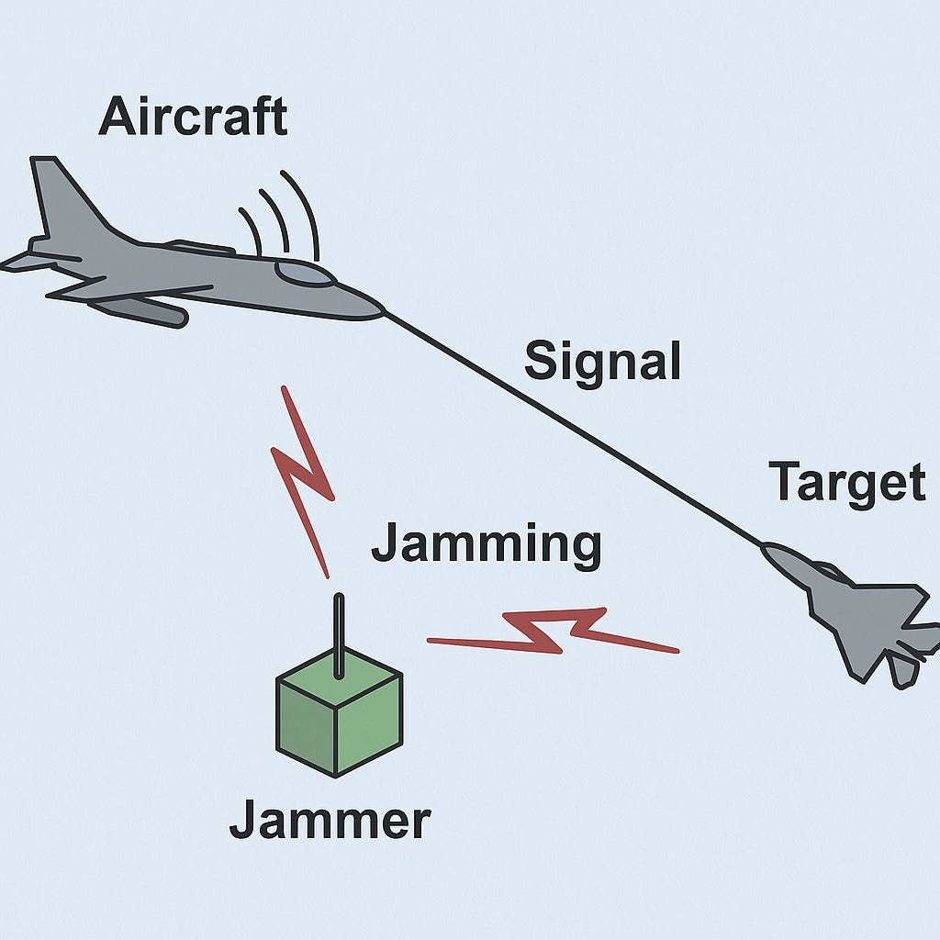
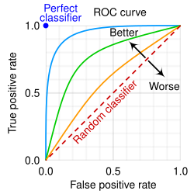
Resiliency, Detectability, and Geolocation of a Waveform
Collaboration with Naval Information Warfare Center, Pacific (NIWC Pac) Division 535
Resiliency – How well does a waveform perform in the presence of noise, interference and/or at range?
Detectability – How easy is the presence of the active waveform to detect?
Geolocation – How precise can a transmitter be located?
Detectability
Resiliency
Geolocation

Slide 4
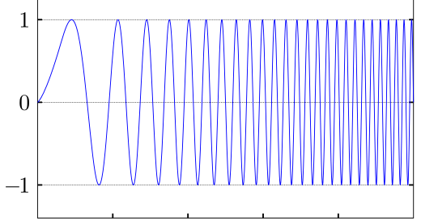
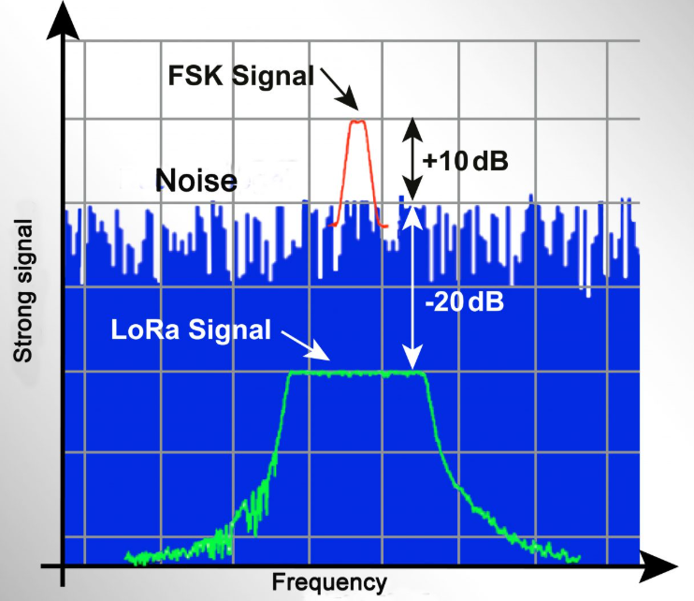
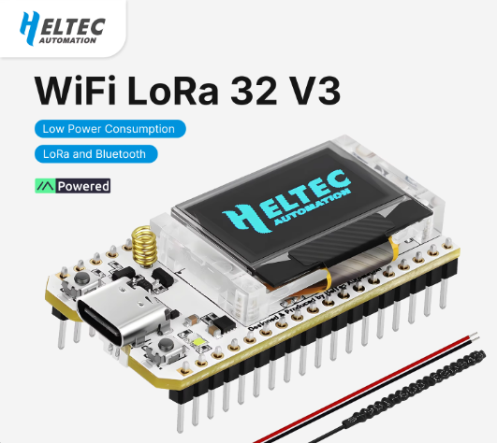
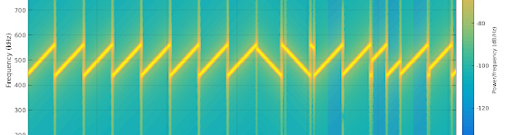
Long Range (LoRa) Chirp Spread Spectrum (CSS)
Proprietary modulation technique
Commercial Off-The-Shelf (COTS)
Extremely Low Cost, Size, and Power consumption
Heltec LoRa V3 dev board (Semtech SX1262)
Notes:
Proprietary modulation technique
Commercial Off-The-Shelf (COTS)
Extremely Low Cost, Size, and Power consumption
Modulation uses “Chirps” – linear sweeps in frequency
Receiver Sensitivity can be below thermal noise floor – valuable for range and resiliency performance
Heltec LoRa V3 dev board (Semtech SX1262)

Slide 5
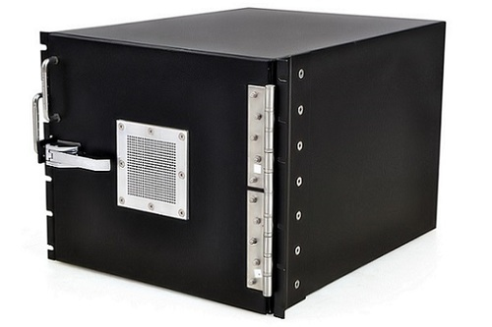
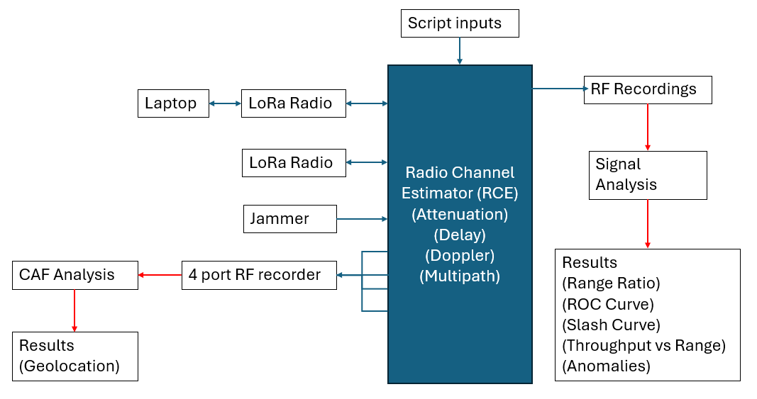

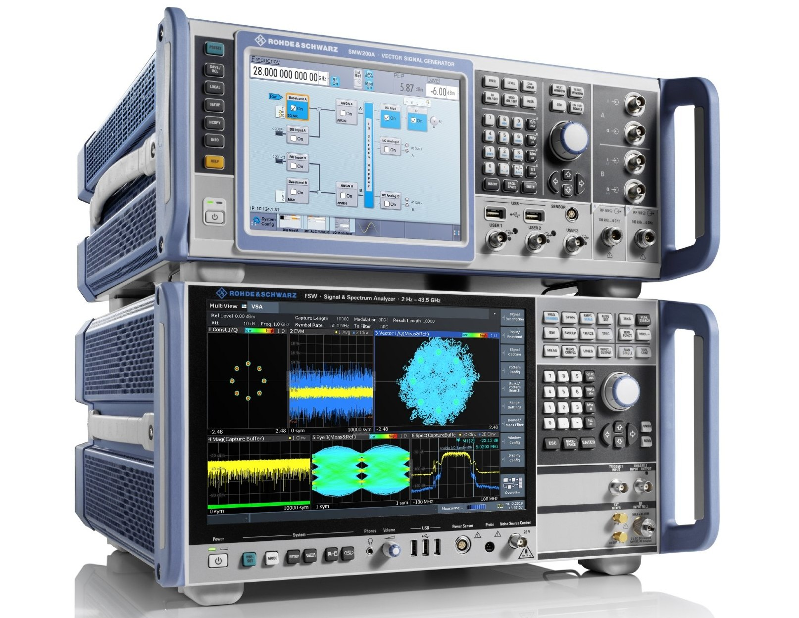

Test Bed and Equipment
Notes:
EW cert
RSSI values in ACK, SNR
Other values

Slide 6
Test Approach
Iterative testing against various LoRa Configurations
Spread Factor (SF) and Bandwidth (BW) variations
Simulated environment
Resiliency
Gaussian Noise
Scenario Driven via Scripts
Detection
Radiometry
MATLAB
Gaussian Noise
Geolocation
Cross Ambiguity Function (CAF)
MATLAB
SF | BW (kHz) | Ts (ms) | # Sym | Rx Sensitivity (dBm) | Thermal noise estimate (dBm) | SNRmin (Therm noise) (dB) | Effective bps
7 | 10.4 | 12.29 | 125.25 | -134 | -133.6 | -0.4 | 455
7 | 20 | 6.14 | 125.25 | -131 | -130.7 | -0.3 | 911
7 | 125 | 1.02 | 125.25 | -124 | -122.8 | -1.2 | 5,468
7 | 500 | 0.26 | 125.25 | -117 | -116.8 | -0.2 | 21,875
12 | 125 | 32.77 | 70.25 | -137 | -122.8 | -14.2 | 293
12 | 500 | 8.19 | 70.25 | -129 | -116.8 | -12.2 | 1,171

Slide 7


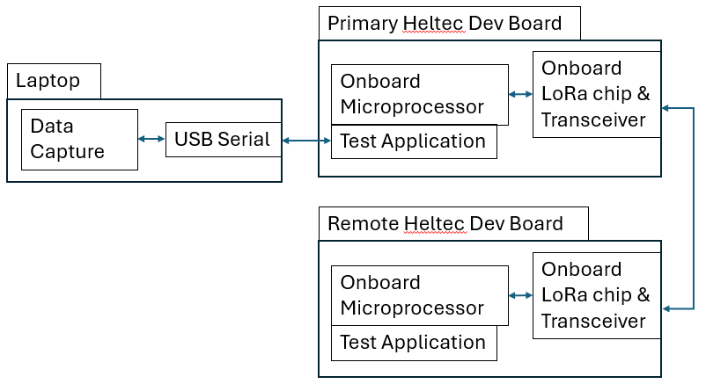
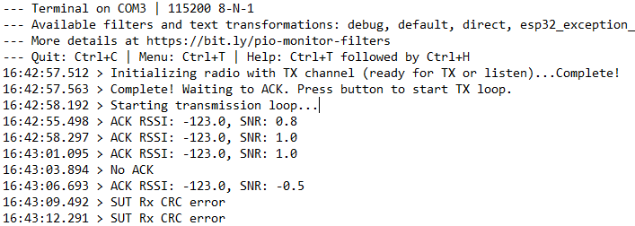
Development Efforts
https://jgromes.github.io/RadioLib/
LoRa development boards (Heltec LoRa V3)
Visual Studio Code C++
Platform IO extension
“Application” traffic exercises waveform signal
50B payload transmitted ~once per second
ACK/NACK between the two with output logging
Single code base for quick uploads between test configs
SF and BW inputs in header file – adjusts dynamically
Code base works as ACK device or Tx device with button toggle
https://github.com/Brycycle/WES-CAPSTONE
Notes:
Published results to find. Google scholar
Connected papers
This weekend.

Slide 8
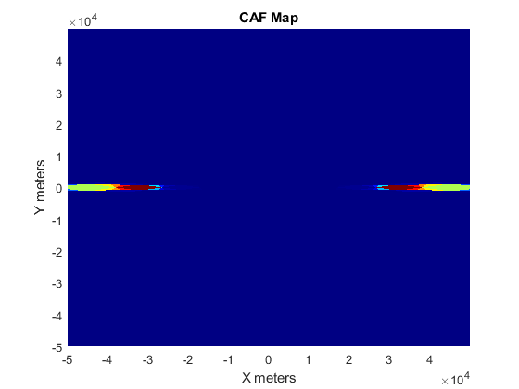
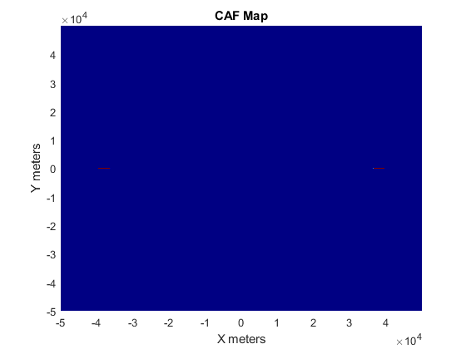
Geolocation Results (CAF)
Top SF 7
(Left-right) BW 10.4k, BW 20k, BW 125k, BW 500k
Bottom SF 12
(Left-right) BW 125k, BW 500k

Slide 9
Geolocation Analysis
Bandwidth | Peak Area (square km) | Effective Data Rate (SF 7)
10.4 kHz | ~ 80 | ~ 450 bps
20 kHz | ~ 75 | ~ 910 bps
125 kHz | ~ 5 | ~ 5,400 bps
500 kHz | <1 | ~ 21,000 bps
Detector Location
Transmitter location
Notes:
4 recorders, 6 2 point CAF outputs combined
No multipath

Slide 10
Probability of Detection Results
Slash Curve (Pd = .85)
Radiometry (energy-based detection)
Empirical Probability Calculations (MATLAB)
Receiver Operating Characteristic (ROC)
Data shown: LoRa SF 7 BW 125kHz
SNR = 0 dB
SNR = -5 dB
SNR = -10 dB
SNR = -15 dB
Notes:
SF7 125k example

Slide 11
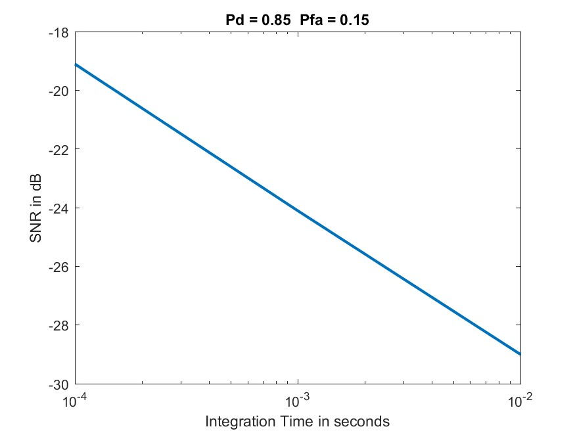
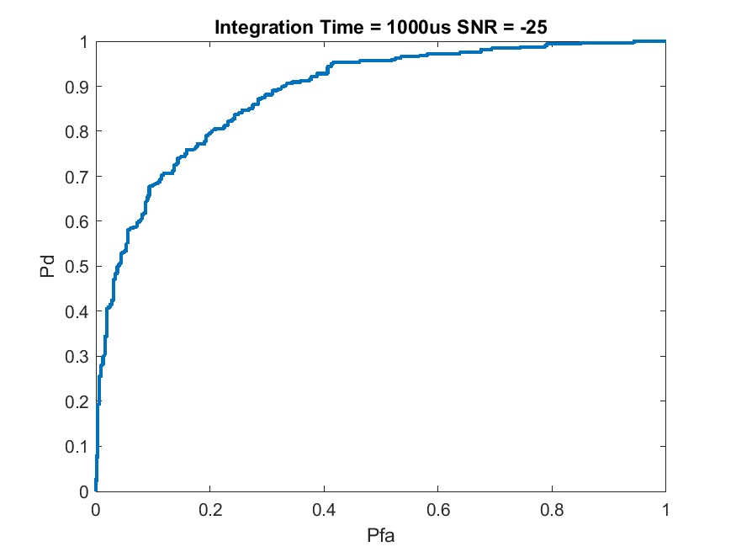
Detection Analysis
LoRa SF 7 BW 125kHz
Spread Factor | Bandwidth | SNR for .85/.15 (Pd/Pfa)
7 | 10.4 kHz | -5 dB
7 | 20 kHz | -5 dB
7 | 125 kHz | -7.5 dB
7 | 500 kHz | -10 dB
12 | 125 kHz | -7.5 dB
12 | 500 kHz | -10 dB
Comparison Waveform
Comparison Waveform = -25 dB SNR
Notes:
Independent of WF operation

Slide 12
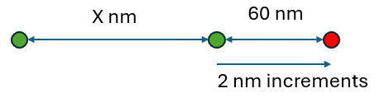
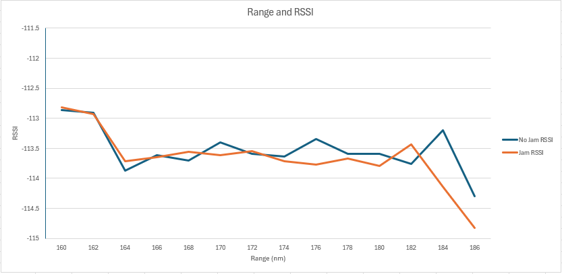
Resiliency Results
Scenario Visual (Script generated)
Questionable validity of results
Recursive improvements to testbed, scripts, and codebase desired.
Deficiencies/limitations:
Equipment
Scripts
Codebase
Scenario
SF 7 BW 500kHz Results
Notes:
SF7 500k example
RFN resolution of attenuation steps at 2nm increments
RFN handling jam-1 and SNR seen at 1-2
hardcoded scripts only 60nm movement - too short for LoRa?
emulated jammer negligible, but legal and easily obtained
packet vs ber goodut

Slide 13
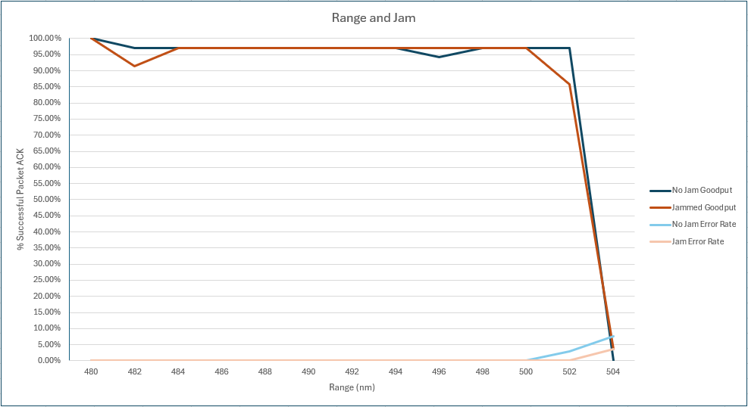
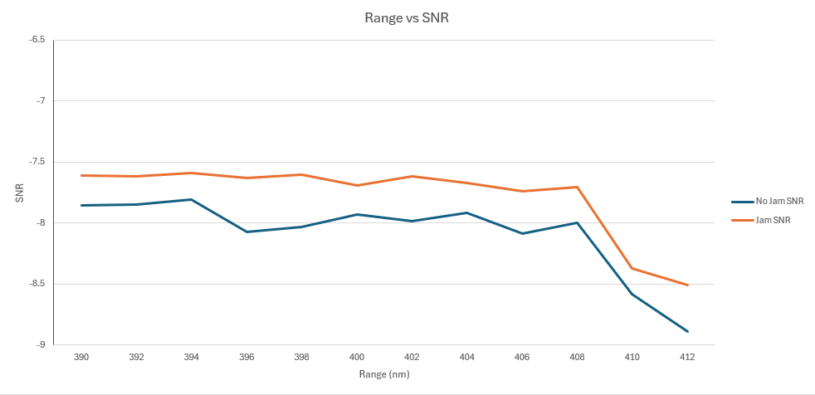
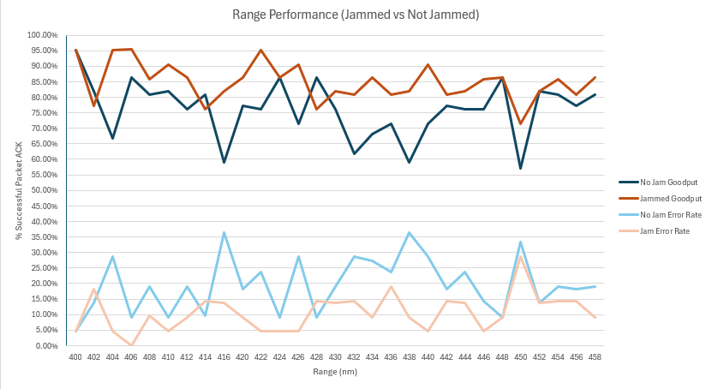
Resiliency Analysis
SF 7 BW 20kHz Results – hard stop and jamming
SF 7 BW 125kHz Results – Jam SNR greater?
LoRa Config | Starting Distance (X)
SF 7 BW 10.4 kHz | 400 nm
SF 7 BW 20 kHz | 480 nm
SF 7 BW 125 kHz | 390 nm
SF 7 BW 500 kHz | 160 nm
SF 12 BW 125 kHz | 500 nm
SF 12 BW 500 kHz | 480 nm
SF 7 BW 10kHz Results – significant fluctuation, no falloff?
Notes:
Independent of WF operation

Slide 14
Thank You
Notes:
Independent of WF operation

